Slide 1
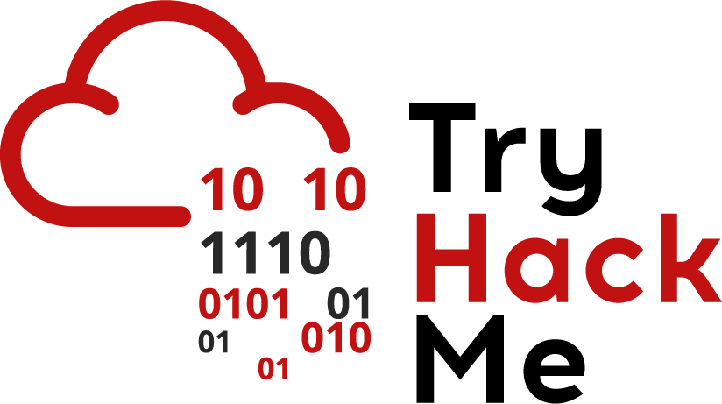


Cyber Kill Chain
Eng. Mahmoud Hassan

Slide 2
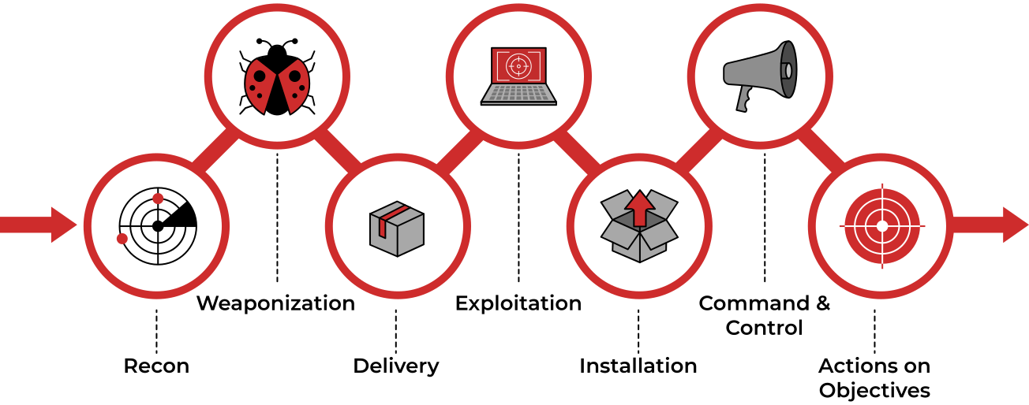
Cyber Kill Chain

Slide 3


Weaponization
Key Terminology:
Malware: A program or code designed to damage, disrupt, or gain unauthorized access to a system (e.g., ransomware, keylogger).
Exploit: A program or code that takes advantage of a vulnerability or flaw in a system or application. (e.g., EternalBlue, phishing email).
Payload: The malicious part of the malware that is executed on the victim's system. (e.g., encrypting files, recording keystrokes).
Example (1):
The attacker uses the EternalBlue exploit which exploits a vulnerability in the SMB protocol to breach a vulnerable system. Once inside, the payload (WannaCry) is delivered and executed then malware (ransomware) encrypts the victim’s files and demands payment.
Example (2):
The victim opens a malicious Word document attached to a phishing email. The exploit in the document takes advantage of a vulnerability in Word to execute the payload (keylogger). The malware (keylogger) then runs in the background, stealing sensitive information like passwords and credit card numbers.

Slide 4
Weaponization
What is Weaponization?
Weaponization is the process of combining malware with exploits to create a malicious payload that can be delivered to the victim. According to Lockheed Martin, this process involves turning malicious tools into something deliverable (like a file or link) that can be used to breach the system.
How is Weaponization Done?
Attackers typically use automated tools to generate malware or purchase it from the DarkWeb. However, more sophisticated attackers (such as nation-sponsored APT groups) write their own custom malware to make it unique and avoid detection by security systems.
What Does "Megatron" Do in This Phase?
In our scenario, "Megatron" decides to purchase a pre-written payload from the DarkWeb instead of creating it himself. This allows him to save time and focus on the other phases of the attack.

Slide 5
Weaponization
Examples of Weaponization Techniques:
Creating an Infected Office Document: The attacker can create a Word or Excel document containing a malicious macro or VBA code (Visual Basic for Applications). When the victim opens the document and enables the macro, the malicious code is executed.
Spreading Malware via USB: The attacker can create a sophisticated virus or worm, implant it on USB drives, and distribute them in public places. If a victim plugs the USB into their device, the malicious code is executed.
Using Command and Control (C2) Techniques: These techniques allow the attacker to remotely control the victim's device or deliver additional payloads. You can learn more about these techniques through MITRE ATT&CK.
Installing a Backdoor: A backdoor is a method that allows the attacker to secretly access the victim's system while bypassing security mechanisms.

Slide 6



Thank you
+201116735630
mahmoudhassan2947@gmail.com
www.linkedin.com/in/mahmoud-hassan-b4400b1b7

